Slide 1

MEDIA KIT
2026
Florida House District 109 • Democrat
Proof. Not Promises. On The Move.
Notes:
Opening frame: introduce the media kit and campaign identity for James Bush III, Democrat for Florida House District 109. Use the phrase: Proof. Not Promises. On The Move.

Slide 2
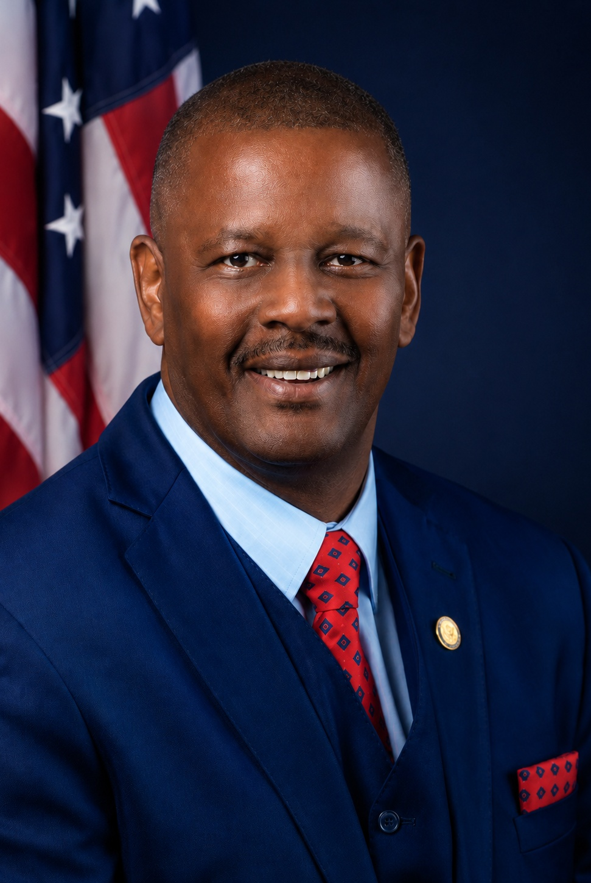
01
CANDIDATE SNAPSHOT
James Bush III at a glance
Educator. Minister. Community advocate. Former State Representative.
• Democratic Candidate for Florida State Representative, House District 109
• Campaign message: On The Move
• Theme: Proof. Not Promises.
• Election Day: August 18, 2026
• Website: JamesBushIII.com
MEDIA CONTACT: HQ JAMES BUSH III
786-499-9493 | Info@JamesBushIII.com
Notes:
Snapshot source: campaign press release provided in the media packet. Keep introduction concise and credential-led.

Slide 3

02
CORE MESSAGE
Proof, not promises.
The campaign centers experience, community trust, and a record of delivering resources home for Miami-Dade families.
PUBLIC STRENGTH
LOCAL PROOF
CLEAR ASK
A recognizable public servant with legislative and local roots.
A campaign framed around measurable wins, not polished guesses.
Vote, volunteer, donate, request a yard sign, and stay connected.
James Bush III for Florida House District 109 | Democrat | Election Day: August 18, 2026
JamesBushIII.com
Notes:
Use this slide to anchor the narrative. Three pillars: public strength, local proof, and clear civic action.

Slide 4
03
RECORD OF RESULTS
Key wins reporters can verify and voters can feel
$33M
$1.5M
30
Secured for Florida HBCUs
Voted for Liberty City Health Clinic
Years as Miami-Dade public school teacher
• HB 1283: Florida Martin Luther King, Jr. Institute for Non-Violence
• Brownsville Renaissance Shopping Mall and Commercial Business District designation
• Prime Sponsor: Bethune-Cookman University License Plate Tag Bill
• Associate Minister, Antioch Missionary Baptist Church of Brownsville
James Bush III for Florida House District 109 | Democrat | Election Day: August 18, 2026
JamesBushIII.com
Notes:
Key wins are drawn from the campaign press release. Avoid overloading this slide; use it for proof points only.

Slide 5
04
CAMPAIGN PRIORITIES
The agenda: practical, local, and people-first
A media-ready summary of the issues shaping the campaign conversation.
Education
Economic Opportunity
Public Safety
Strong schools, workforce preparation, and support for students and educators.
Better jobs, small business pathways, and investment that reaches neighborhoods.
Safer communities through prevention, accountability, and smart community partnerships.
Senior Services
Youth Development
Community Investment
Respect, resources, and stability for seniors who built the community.
Mentorship, leadership exposure, and opportunity for the next generation.
Resources that come home and stay visible in the district.
James Bush III for Florida House District 109 | Democrat | Election Day: August 18, 2026
JamesBushIII.com
Notes:
Platform priorities reflect campaign focus areas listed in the press release: education, economic opportunity, public safety, senior services, youth development, and community investment.

Slide 6

05
DISTRICT 109 COMMUNITIES
A Miami-Dade campaign built neighborhood by neighborhood
Miami Gardens • Opa-locka • North Miami • Westview • West Little River • Gladeview • Brownsville • Bunche Park • Golden Glades • Biscayne Park • Opa-locka North • Miami-Dade County
Media angle
Cover the campaign as a district-wide conversation about resources, respect, public service, and measurable delivery across Miami-Dade neighborhoods.
LOCAL FRAME
“On The Move” is more than a slogan. It gives reporters a clear story spine: what moved, who benefited, and what comes next for District 109.
James Bush III for Florida House District 109 | Democrat | Election Day: August 18, 2026
JamesBushIII.com
Notes:
Read the district communities as part of the campaign’s local footprint. The slide helps journalists place the campaign geographically.

Slide 7
06
MEDIA BIO
Short-form biography
James Bush III is an educator, minister, community advocate and former State Representative with decades of service to students, families, seniors and neighborhoods throughout Miami-Dade County. His 2026 campaign for Florida House District 109 is built on real leadership, real experience and real results.
Suggested lower-third
James Bush III
Candidate for Florida House District 109
Suggested intro
“Joining us is James Bush III, educator, minister, community advocate and candidate for Florida House District 109.”
JamesBushIII.com
Notes:
This slide provides copy for anchors, hosts, producers, newsletters, and event programs.

Slide 8
07
QUOTE BANK
Ready-to-use campaign quotes
“This election is about proof, not promises. I have spent decades serving students, families, seniors, churches and neighborhoods.”
“District 109 needs experienced leadership that can bring resources home.”
“That means stronger schools, better jobs, safer neighborhoods, respect for seniors and real investment in every part of this district.”
Use for press stories, captions, campaign newsletters, radio scripts, and event introductions.
James Bush III for Florida House District 109 | Democrat | Election Day: August 18, 2026
JamesBushIII.com
Notes:
Quotes are pulled from the press release. Keep quotation marks intact and attribute to James Bush III.

Slide 9
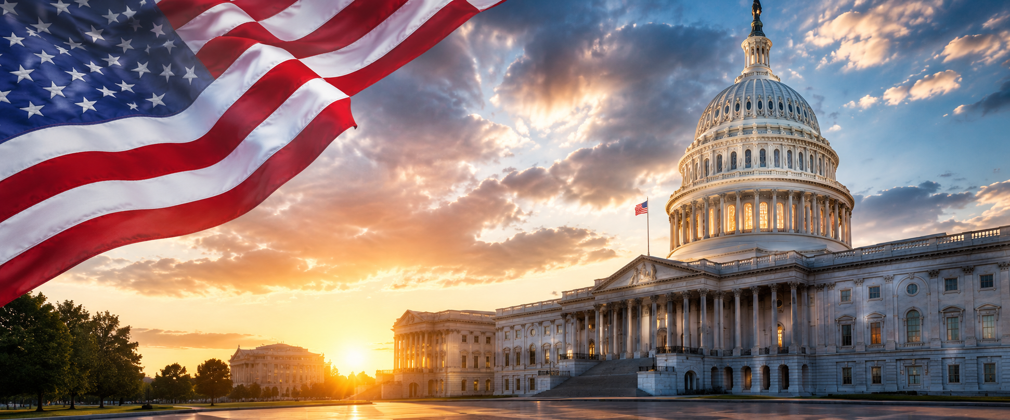
08
PRESS RELEASE + STORY HOOKS
Suggested media angles
• Former State Representative returns with an “On The Move” message
• Experienced educator frames campaign around proof, not promises
• District 109 candidate highlights funding wins and neighborhood investment
• Campaign focuses on education, opportunity, safety, seniors and youth
Suggested headline
James Bush III Highlights Proven Record and “On The Move” Campaign for Florida House District 109
James Bush III for Florida House District 109 | Democrat | Election Day: August 18, 2026
JamesBushIII.com
Notes:
Press release headline and angles are based on the provided refined SEO press release with wins.

Slide 10
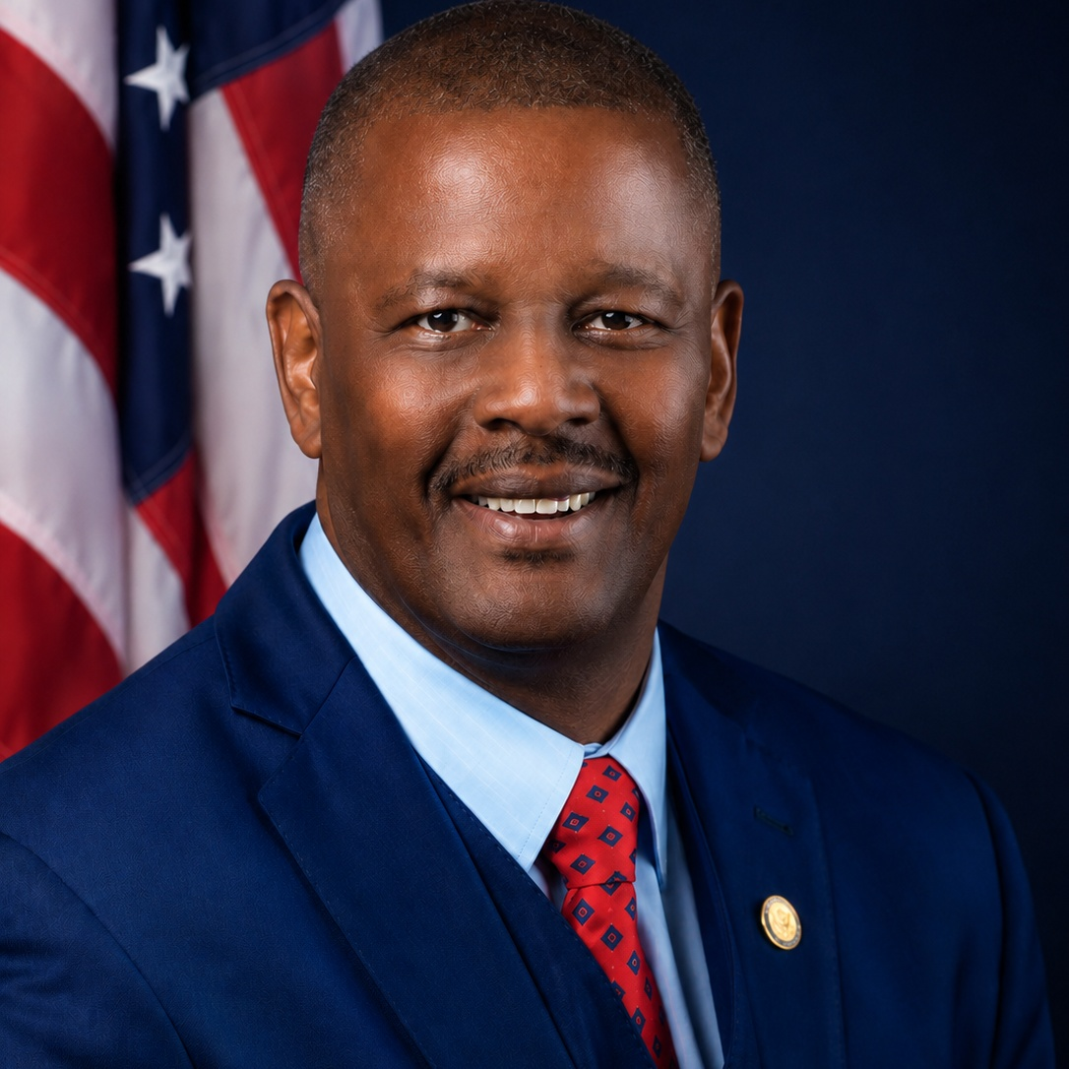

09
VISUAL IDENTITY
Campaign assets: bold, patriotic, legible
Use strong contrast, clean navy/red pairings, and uncluttered layouts. The brand should feel steady, experienced, and ready for public view.
Cover / social banner
Primary logo with three solid stars
Candidate portrait
Color cues: Deep Navy #062B5F | Campaign Red #D1121B | White #FFFFFF
Typography direction: bold uppercase headlines, clean sans-serif body copy, generous spacing, high contrast.
James Bush III for Florida House District 109 | Democrat | Election Day: August 18, 2026
JamesBushIII.com
Notes:
Brand slide is designed for media, volunteers, vendors and designers. It gives practical use guidance without overcomplicating the kit.

Slide 11
10
DIGITAL MESSAGING
Fast copy for posts, captions and email blasts
Sample post
Call to action menu
District 109 deserves leadership with receipts. James Bush III is On The Move for stronger schools, better jobs, safer neighborhoods, respect for seniors and real investment in our communities. Election Day: August 18, 2026.
• Make a plan to vote
• Volunteer with the campaign
• Donate to support voter outreach
• Request a yard sign
• Share the media kit with press and partners
#JamesBushIII #OnTheMove #District109 #MiamiDade #Vote2026
James Bush III for Florida House District 109 | Democrat | Election Day: August 18, 2026
JamesBushIII.com
Notes:
Use this slide when preparing social posts and campaign emails. Adjust hashtags based on platform, but keep the proof-not-promises message consistent.

Slide 12
Media ready. Community rooted. On the move.
James Bush III (D) for Florida House District 109
Democrat • Election Day: August 18, 2026
MEDIA CONTACT
HQ James Bush III
786-499-9493 | Info@JamesBushIII.com
PROOF. NOT PROMISES. ON THE MOVE.
Ready for interviews, features, forums and community coverage.
JamesBushIII.com
Notes:
Closing slide: use it as a final leave-behind in email attachments and press briefings.

